Slide 1
Single Image Super Resolution
Gabriel Yuan

Slide 2


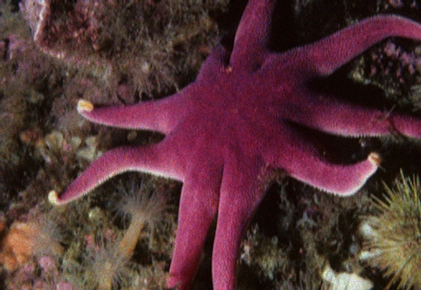
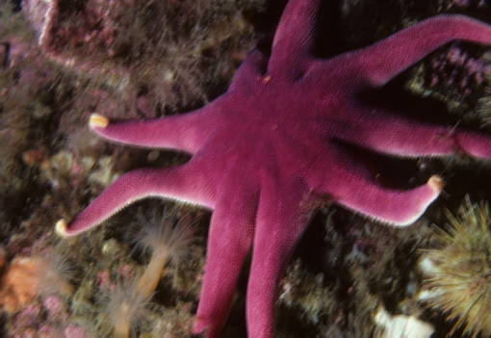
Task
degradation model
CNN
LR HR
Notes:
Image SR is ill-posed, since there exists multiple solutions for any LR input, trying to reconstruct the high-frequency info
The main purpose is to restore high frequency details
Yu, X., Fernando, B., Hartley, R., & Porikli, F. (2018). Super-resolving very low-resolution face images with supplementary attributes. In Proceedings of the IEEE Conference on Computer Vision and Pattern Recognition (pp. 908-917).

Slide 3
Category
Single Image Super Resolution (SISR)
Degradation Model (Blur kernel in SR, lens for SR)
Attention Mechanism (Spatial and Channel-Wise Attention)
Texture Synthesis (GAN)
Prior information
Reference based Super Resolution (RefSR)
How to transfer the details from references to LR image?
How to require the references?
How to embed the information into the SR process?
Notes:
Induce extra texture/high-frequency details for SR

Slide 4
Dataset
Traditional Dataset：DIV2K，Set5，Set14等
Feature：LR images are downsampled from the HR images, and then blur kernel and noise are added on
Real-world：GAN to generate real-world LR images[1]， Use different camera lens to capture the dataset[2]， Generate the blur kernel [3]
Fearure：The SR model trained by these data have a better robust performance in the real-world
Synthesised dataset
[1] Bulat, A., Yang, J., & Tzimiropoulos, G. (2018). To learn image super-resolution, use a GAN to learn how to do image degradation first. In Proceedings of the European Conference on Computer Vision (ECCV) (pp. 185-200).
[2] Zoom to Learn, Learn to Zoom(CVPR2019)
[3] Zhang, K., Zuo, W., & Zhang, L. (2018). Learning a single convolutional super-resolution network for multiple degradations. In Proceedings of the IEEE Conference on Computer Vision and Pattern Recognition (pp. 3262-3271).
Notes:
[1] Bulat, A., Yang, J., & Tzimiropoulos, G. (2018). To learn image super-resolution, use a GAN to learn how to do image degradation first. In Proceedings of the European Conference on Computer Vision (ECCV) (pp. 185-200).
[2] Zoom to Learn, Learn to Zoom(CVPR2019)
[3] Zhang, K., Zuo, W., & Zhang, L. (2018). Learning a single convolutional super-resolution network for multiple degradations. In Proceedings of the IEEE Conference on Computer Vision and Pattern Recognition (pp. 3262-3271).

Slide 5
Loss Function
Main：PSNR，SSIM
Both are vector norms, which are calculated by MSE.
Loss Function：MSE
PSNR correlate poorly with the human perception of image quality
Addition：
Perceptual loss：Pixel-wise loss on the feature maps gained by VGG(including spatial info)
Contextual loss： Feature operations for unaligned images(no spatial info)
CoBi loss：Improvement for the Contextual loss(including spatial info)

Slide 6
Paper list
Learning a Deep Convolutional Network for Image Super-Resolution, Chao Dong et al.
Photo-Realistic Single Image Super-Resolution Using a Generative Adversarial Network, Christian Ledig et al. CVPR2017
Recovering Realistic Texture in Image Super-resolution by Deep Spatial Feature Transform, Xintao Wang et al. CVPR2018
Image Super-Resolution Using Very Deep Residual Channel Attention Networks, Yulun Zhang et al. ECCV2018
Channel-wise and Spatial Feature Modulation Network for Single Image Super-Resolution, Yanting Hu et al. IEEE Transactions on Circuits and Systems for Video Technology 2019
Image Super-Resolution by Neural Texture Transfer, Zhifei Zhang et al. CVPR2019

Slide 7
Learning a Deep Convolutional Network for Image Super-Resolution
Chao Dong Kaiming He

Slide 8
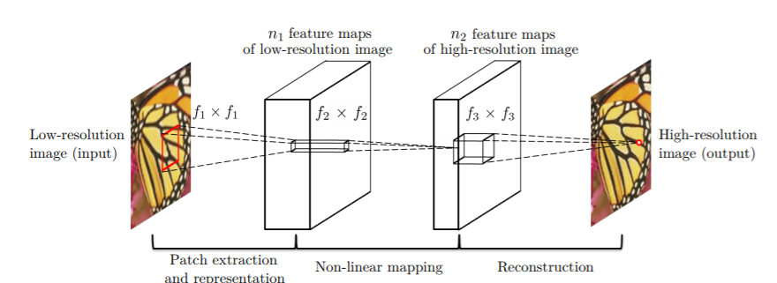
Highlights
First work using CNN on super resolution
MSE-oriented method, directly learn the mapping
Notes:
Dong, C., Loy, C. C., He, K., & Tang, X. (2015). Image super-resolution using deep convolutional networks. IEEE transactions on pattern analysis and machine intelligence, 38(2), 295-307.

Slide 9
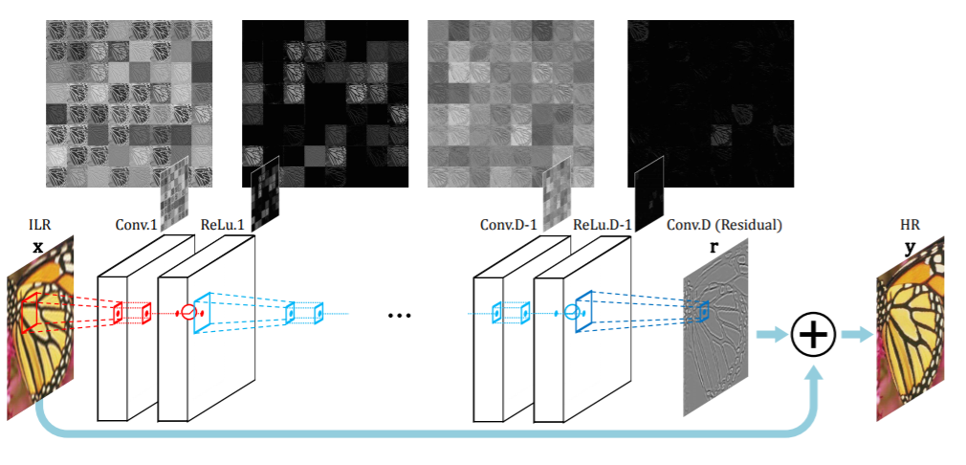
Consclusion
LR needs to upsample at first
Simply deepen the network has no improved performance (VDSR[1])
[1] Accurate Image Super-Resolution Using Very Deep Convolutional Networks CVPR2016 oral

Slide 10
Photo-Realistic Single Image Super-Resolution Using a Generative Adversarial Network
Christian Ledig et al
Twitter

Slide 11
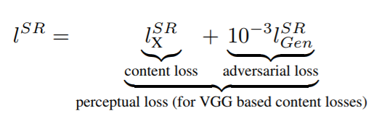
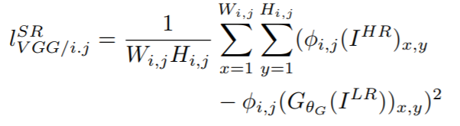
SRGAN
Total Loss：
Perceptual Loss：
With φi,j we indicate the feature map obtained by the j-th convolution (after activation) before the i-th maxpooling layer within the VGG19 network
Notes:
Ledig, C., Theis, L., Huszár, F., Caballero, J., Cunningham, A., Acosta, A., ... & Shi, W. (2017). Photo-realistic single image super-resolution using a generative adversarial network. In Proceedings of the IEEE conference on computer vision and pattern recognition (pp. 4681-4690).

Slide 12
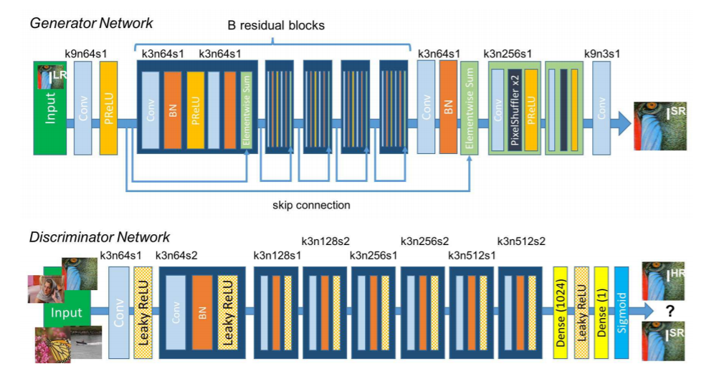
SRGAN
Notes:
Ledig, C., Theis, L., Huszár, F., Caballero, J., Cunningham, A., Acosta, A., ... & Shi, W. (2017). Photo-realistic single image super-resolution using a generative adversarial network. In Proceedings of the IEEE conference on computer vision and pattern recognition (pp. 4681-4690).

Slide 13
Conclusion
Simply using MSE loss function will occur over-smooth problem though the metrics are high but the visual quality is not satisfying
Needs a pretrained model, unlike the tradition GAN you’d better not balance the G and D. In SRGAN, it is essential to pretrain a MSE oriented model and the fine tune with the discriminator.
Weight for D should not be too big, 5e-3

Slide 14
Recovering Realistic Texture in Image Super-resolution by Deep Spatial Feature Transform
Xintao Wang Ke Yu
CUHK - SenseTime Joint Lab , SenseTime Research

Slide 15
Attribute/Prior
For face super-resolution, the researchers used Heat maps [9] (learned by neural networks), face high-dimensional features [19] to reconstruct extremely blurred LR images.
For the license plate/text super-resolution, the best semantic feature is his string, [11] using the recognized string as a condition in the CGAN to generate a high-definition license plate.
In order to be able to integrate features into the neural network, the Encoder-Decoder structure is commonly used.

Slide 16
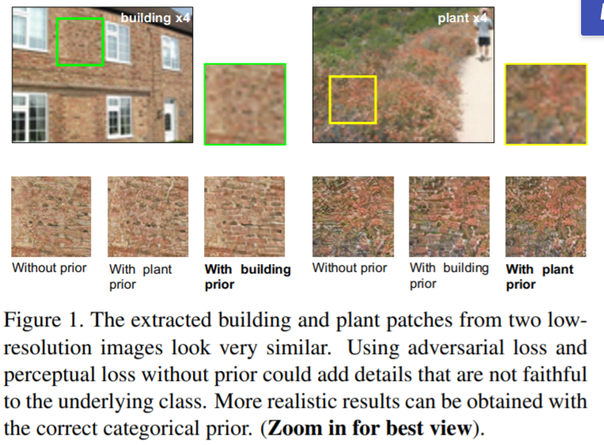
Semantic Prior
It is possible to recover textures faithful to semantic classes
Notes:
we show that it is possible to recover textures faithful to semantic classes,
Specifically, we try to restore the visually ambiguous plant and building pairs using two different CNN models, each of which is specially trained on a plant dataset and a building dataset

Slide 17


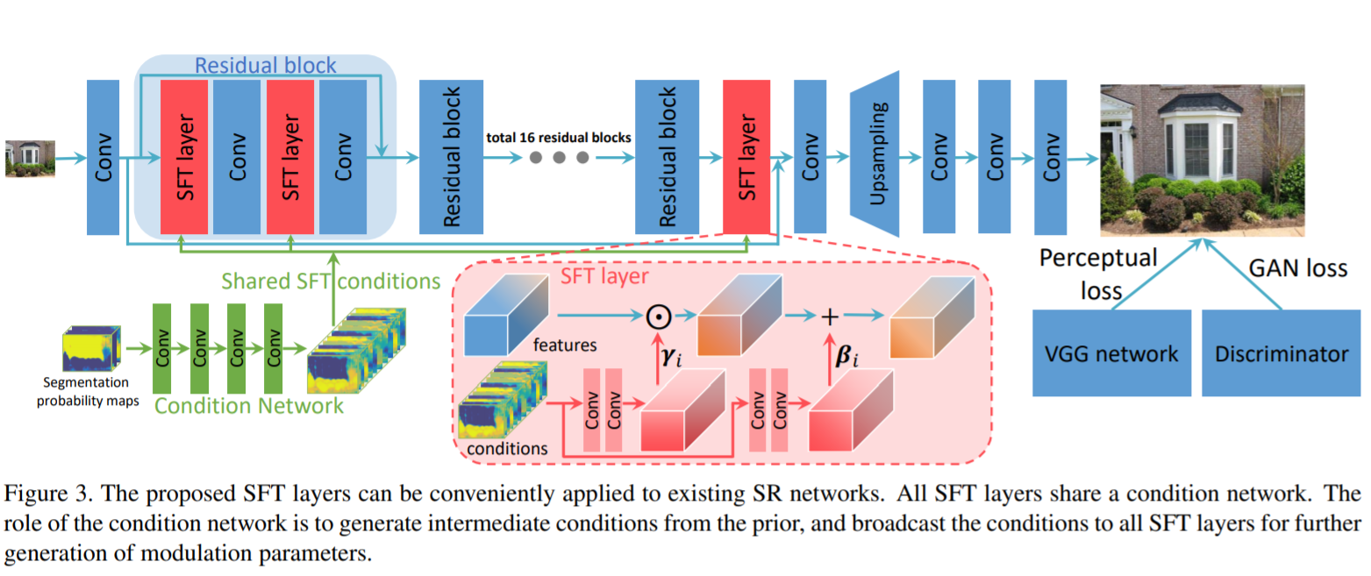
Spatial Feature Transfer

Slide 18


Other tech
References to provide texture information
There are alternative ways to introduce categorical priors.
Brute-force reconstruct each region with specific model
Concatenate the segment with LR
Concatenate the segment with feature maps
CNN
CNN
CNN
CNN
CNN
Notes:
简单的为特征添加有条件的偏差，不像SFT一样直接进行仿射变换，SFT的一种特例

Slide 19
Image Super-Resolution Using Very Deep Residual Channel Attention Networks
Yulun Zhang , Kunpeng Li
Northeastern University

Slide 20
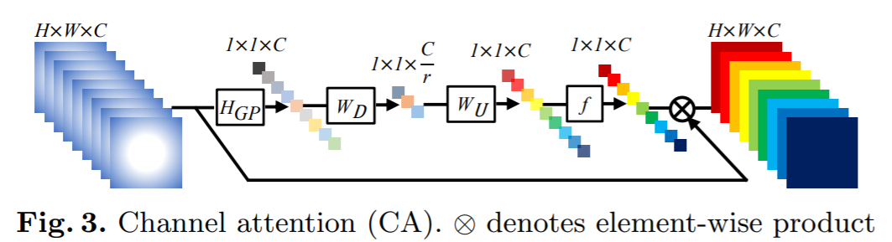
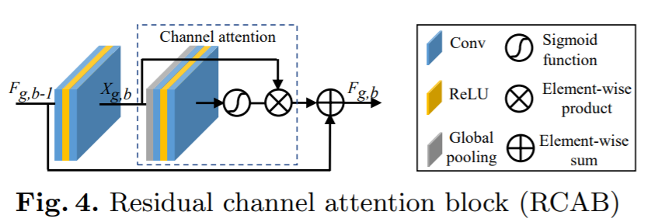
Channel Attention Mechanism
Channel-wise attention: Features in different channels should be treated separately
Residual Channel-wise attention(RCA)
Notes:
如上所述，Res Block和Skip Connection允许网络的主要部分集中于LR特征的更多信息性组件。

Slide 21
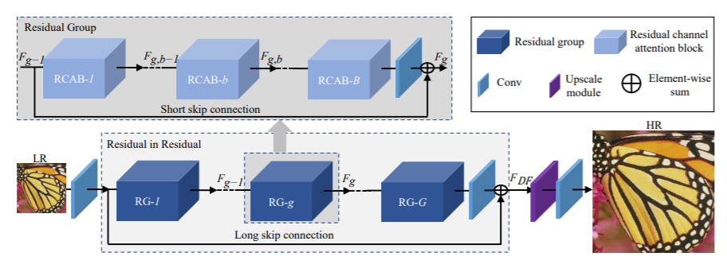
Residual in Residual(RIR)
RIR block, has a long skip connection to bypass low-frequency information.
Force the network pay attention on the informative features
Notes:
This module contains a long skip connection and a short skip connection
Too deep a network layer can lead to training difficulties (400 layers)
Long connection: similar to VDSR, because simply add residual blocks will not have good results
Short link: Add skip connection during increasement of Attention block
The low frequency between LR and HR is similar, and skipped with skip connection

Slide 22
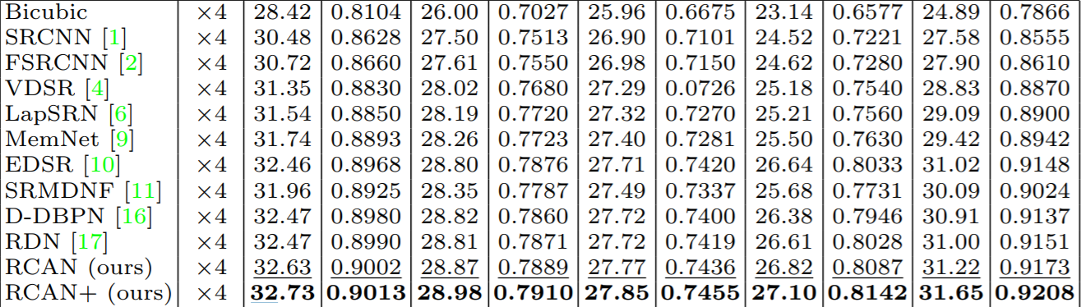
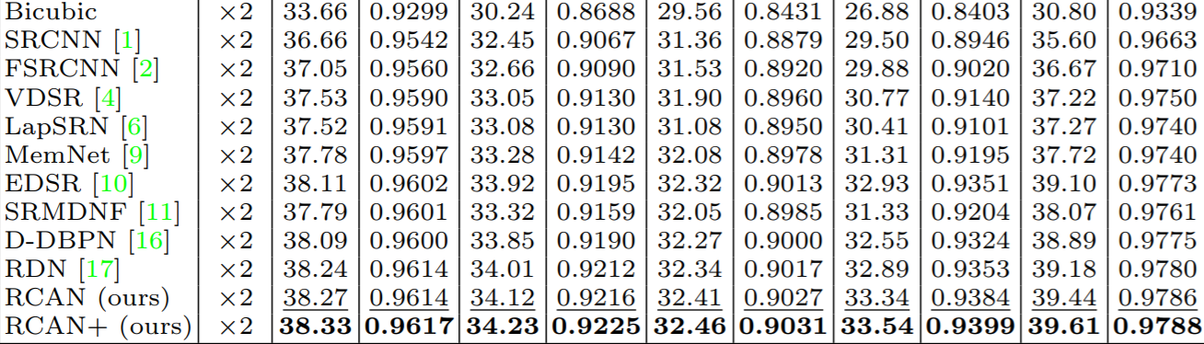
Improvement

Slide 23
Image Super-Resolution by Neural Texture Transfer,
Zhifei Zhang
Adobe

Slide 24
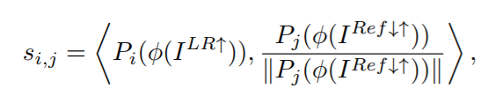
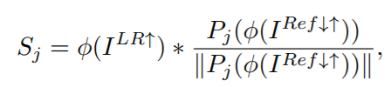

How to transfer the details from reference to LR?
By doing the swapping operation between upsampled LR and reference image
Could be implemented efficiently by convolution operation

Slide 25
Neural Style Transfer
Convolution Kernel, total is N
Channel is N

Slide 26
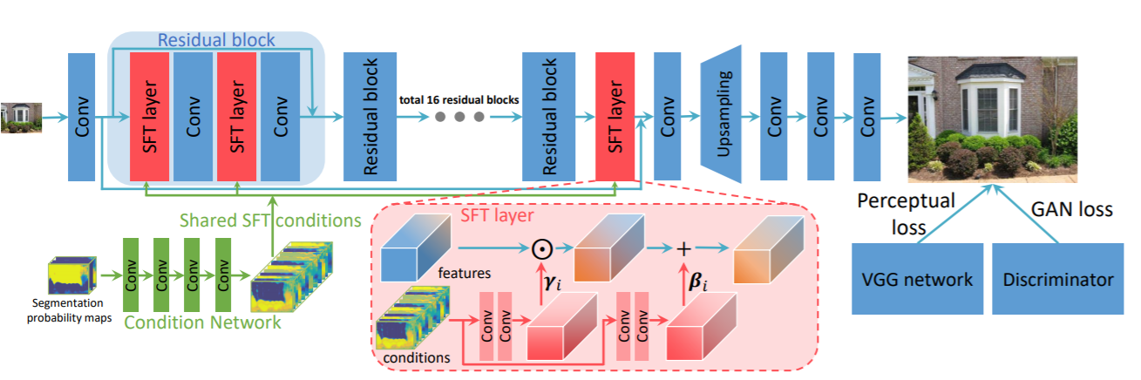
问题
1. 如何引入先验知识：人脸场景中可以引入热力图，高维语义特征向量；车牌超分可以引入车牌字符串信息；[1] 中引入高级语义信息（分割图），提供的信息过少，没有明确的引入自然HR图片先验
《Recovering Realistic Texture in Image Super-resolution by Deep Spatial Feature Transform》
Xintao Wang ¹ Ke Yu ¹ Chao Dong ² Chen Change Loy ¹ CVPR 2018

Slide 27
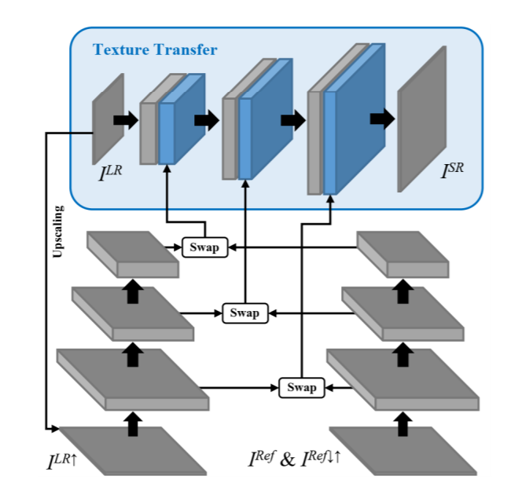
问题
2. 跨界的风格迁移：[2] 中提出使用风格迁移手法将外界HR图片的特征加入到SR主模块中，其中swap过程是offline的，面对多张references时很耗时
《Image Super-Resolution by Neural Texture Transfer》
Zhifei Zhang Adobe Zhaowen Wang CVPR 2019

Slide 28
Insight
是一个Reference-based的方法：使用额外的高清图片增加SR过程中的纹理等高频细节特征，即使用VGG提取references的特征然后聚合在SR主网络中
Segmentation Attention模块：使用高级语义信息引导特征的聚合，使用分割图（暂定7类加默认类）对三个尺度的特征进行引导
辅助loss：Reference Feature与Original Feature之间的loss（实现细节没有敲定）

Slide 29






Segmentation Attention
Conv
Conv
Conv
Conv
Conv
Conv
...
...
...
References
Low-level Feature
Medium-level Feature
High-level Feature
Conv
Conv
Conv
Pool
Conv
Conv
Pool
Conv
Pool
Segmentation
Low-level Weight
Medium-level Weight
High-level Weight

Slide 30

Model
Res
UP
Res
UP
Res
UP
LR
HR
Segmentation Attention
References
Segmentation Probability Map

Slide 31
Thank you

